Slide 1
Word Lesson 2 Basic Editing
Microsoft Office 2010 Introductory
Pasewark & Pasewark

Slide 2
Objectives
Show and hide formatting marks.
Select text.
Create paragraphs without blank space between them.
Undo, redo, and repeat recent actions.
Move and copy text using drag-and-drop and the Clipboard.
2
2

Slide 3
Objectives (continued)
Use the Office Clipboard.
Find and replace text, and use the Go To command.
Identify the number of words in a document or a selection.
3
3

Slide 4
Vocabulary
Clipboard
copy
cut
drag
drag-and-drop
format
Office Clipboard
paste
select
toggle
4
4

Slide 5
Editing Text
In this lesson, you will learn how to show and hide formatting marks, select text, and remove extra space after paragraphs.
You will also undo and redo actions, move and copy text, and locate and replace text.
Finally, you will learn how to jump to a location in a document, and count the words in a document or a selection of text.
5
5

Slide 6
Showing Formatting Marks
Many times it is easier to edit text if you can view the formatting symbols.
The Show/Hide ¶ command allows you to see these hidden formatting marks.
To view the formatting marks, click the Show/Hide ¶ button in the Paragraph group on the Home tab. The formatting marks do not appear when you print your document.
6
6

Slide 7
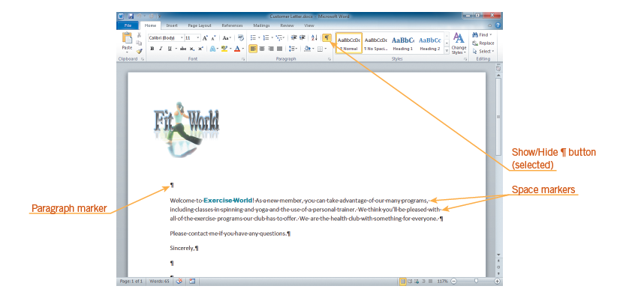
Showing Formatting Marks (continued)
Formatting marks displayed
7
7

Slide 8
Understanding Toggle Commands
Clicking the Show/Hide ¶ button once displays paragraph and formatting marks; clicking the button again hides them. Switching between two options in this manner is known as toggling,
A command that you use by turning a feature on or off is sometimes known as a toggle command.
8
8

Slide 9
Selecting Text
To select text means to highlight a block of text.
You can select text using the mouse, using the keyboard, or using the keyboard in combination with the mouse.
9
9

Slide 10
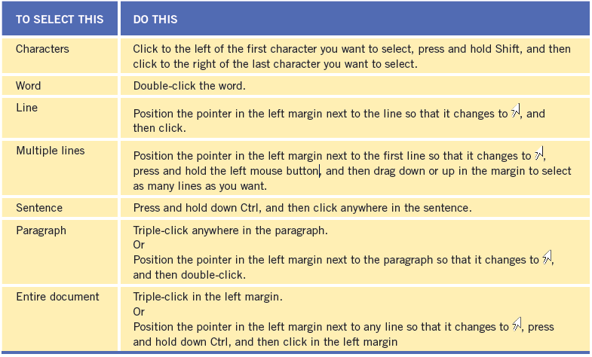
Selecting Text (continued)
Selecting blocks of text

Slide 11
Creating Paragraphs Without Blank Space Between Them
When you press Enter, you create a new paragraph. When you create a new paragraph, the default style is for extra space to be added after the original paragraph.
You can format a paragraph so that it does not have extra space after it. To format text or paragraphs means to change its appearance.
11
11

Slide 12
Using the Undo, Redo, and Repeat Commands
The Undo command reverses recent actions. To use the Undo command, click the Undo button on the Quick Access Toolbar.
The Redo command reverses an Undo action.
The Repeat command repeats the most recent action.
12
12

Slide 13
Using Drag-and-Drop to Move and Copy Text
The easiest way to move text is to drag the text to the new location. This is called drag-and-drop.
As you drag the selected text, a vertical line follows the pointer indicating where the text will be positioned.
To copy the text instead of moving it, press and hold CTRL while you drag it.
13
13

Slide 14
Using the Clipboard to Move and Copy Text
The Clipboard is a temporary storage place in the computer’s memory. To use the Clipboard, you cut or copy text.
The Clipboard can hold only one selection at a time.
The Clipboard is available to all the programs on your computer, and it is sometimes called the system Clipboard.
14
14

Slide 15
Using the Clipboard to Move and Copy Text (continued)
When you use the Paste command, the Paste Options button appears below and to the right of the pasted text.
Usually you can paste the text so:
- The text’s appearance matches the original appearance (source formatting).
- The text’s appearance matches or merges with the text in the location where it is being pasted (destination formatting).
15
15

Slide 16
Using the Office Clipboard
The Office Clipboard is a special clipboard where you can collect up to 24 selections. It is available to Microsoft Office programs.
Unlike the system Clipboard, which is available all the time, you must activate the Office Clipboard to use it.
You can use the Office Clipboard to copy content between Office programs.
16
16

Slide 17
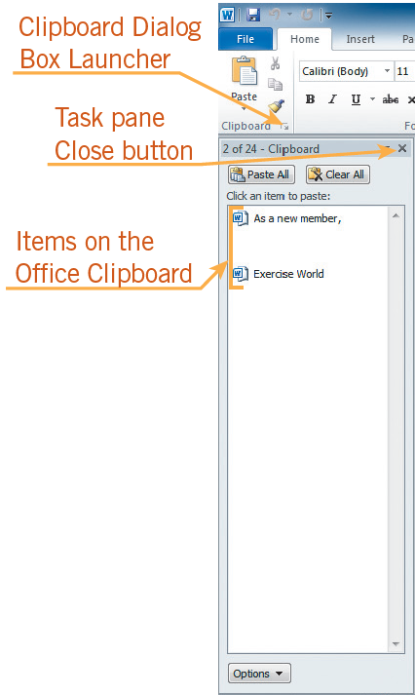
Using the Office Clipboard (continued)
Clipboard task pane with two items collected on it

Slide 18
Using the Find and Replace Commands
Find and Replace are located in the Editing group on the Home tab.
To find text, type it in the Search Document box in the Navigation Pane.
To replace text, open the Find and Replace dialog box, type the text in the Find what box, and then type the replacement text in the Replace with box.
18
18

Slide 19
Using the Find and Replace Commands (continued)
Replace tab in the Find and Replace dialog box
19
19

Slide 20
Using the Go To Command
Go To allows you to jump to a specific part of a document.
On the Home tab, in the Editing group, click the arrow next to the Find button, and then click Go To on the menu.
The Find and Replace dialog box opens with the Go To tab on top.
20
20

Slide 21
Identifying the Number of Words in a Document or Selection
The number of words in a document appears in the status bar and is updated as you type.
If you select text, the status bar displays the number of words in the selection.
You can find the number of characters, paragraphs, and lines in a document by opening the Word Count dialog box.
21
21

Slide 22
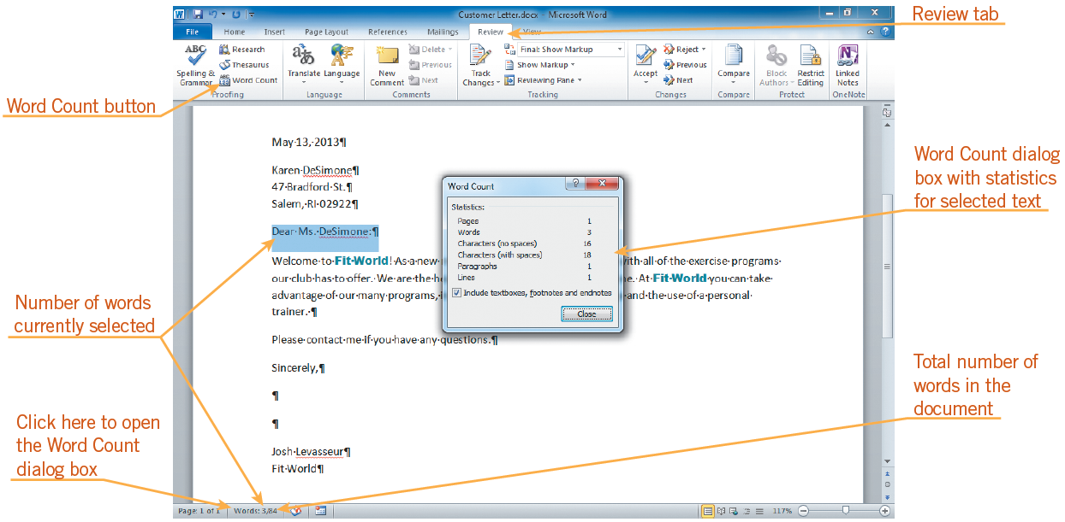
Identifying the Number of Words in a Document or Selection (continued)
Word count on the status bar and in the Word Count dialog box
22
22

Slide 23
Summary
In this lesson, you learned:
You can select blocks of text to perform operations on the entire block of text at once, such as cutting, copying, and pasting.
The Show/Hide ¶ command allows you to view hidden formatting marks. The Show/Hide ¶ button is a toggle command, which means you can turn the feature on or off.
You can change the space before and after a paragraph by using the Line and Paragraph Spacing button in the Paragraph group on the Home tab.
23
23

Slide 24
Summary (continued)
You can undo recent actions by using the Undo command. When you click the arrow next to the Undo button, a list of your recent actions appears. You can redo an action using the Redo button and repeat an action using the Repeat button.
You can drag selected text to a new location in the document. You can press and hold the Ctrl key to copy the selected text rather than move it when you drag.
24
24

Slide 25
Summary (continued)
You can send text to the Clipboard by using either the Cut or Copy command. You can paste text stored on the Clipboard by using the Paste command. If you want to collect more than one item at a time to paste, you can use the Office Clipboard.
The Find command opens the Navigation Pane with the “Browse the results from your current search” tab selected. You type a word or phrase in the Search Document box to highlight every instance of the word in the document and display a list of snippets containing the word in the Navigation Pane.
25
25

Slide 26
Summary (continued)
The Replace command opens the Replace tab in the Find and Replace dialog box, finds the next occurrence of the word or phrase for which you are searching and replaces it with the word or phrase you type in the Replace with box.
The Go To command moves the insertion point to a part of the document that you specify.

Slide 27
Summary (continued)
You can see the number of words in a document or a selection by checking the status bar. You can see the number of characters, paragraphs, and lines in a document or selection by opening the Word Count dialog box.

